Slide 1
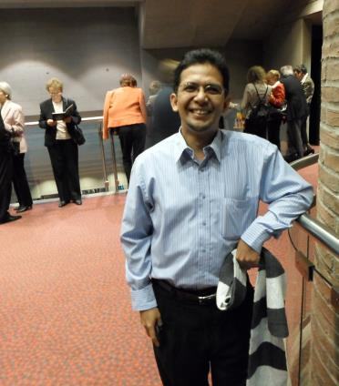
About Me
Mudrik Alaydrus
Philharmonie, München, Dec 2012
Born in Jakarta 1971
Dr.-Ing. 2001
At UMB since 2003
Professor 2014
Postdocs: 2002, 2006, 2009, 2012
Over 160 publications
Scholar google h-index 12,
Scopus h-index 8
4 textbooks,
6 keynoted speeches,
3 Hak cipta dan 2 patents (P00201608738, S0020160957)
Member of VDE (German Assoc. of Electrical Eng.)
Senior Member of IEEE
Best Reseacher Award UMB 2007
Best Reseacher Award UMB 2013
Dosen berprestasi Kopertis III 2015
UMB Award 2015
One wife and five children
2003-2004 Head of Dept. EE (S1)
2008 Dean of Faculty of Computer Sciences
2007-2018 Head of Master Program in EE
2019-now Director of Graduate Program
Stand: 25 Nov 2019

Slide 2
Dipl.-Ing. in Hannover
Start Dr. in Wuppertal
Starting from scratch in beloved country
Emeritus
Radar Technology
Sensor Applications
Heating with Microwaves
(4) Through-Wall-Imaging
Wuppertal’s Time:
Numeric. Electromagnetics,
Effects electromagnetic fields to biological bodies, geophysical exploration with electromagnetic waves
2nd book
Starting study in D
Postdoc
3rd book,
Professor
Postdoc
First researches in Electromagnetics
Dr.-Ing.
Multiband antenna, MIMO Systems
RFID
Material-Electromagnetic interaction
Microwave Filter+Multiplexer
Biometry Signal Processing
Postdoc, 1st book
born
Start UMB
2009
2036
1971 ..
2006
NOW
1990
2003
2011
1997
2001
2012
2014
1994-1997
1997-2002
2003-2008
2009-2020
2021-2036
0 19 26 30 32 43 65

